Slide 1
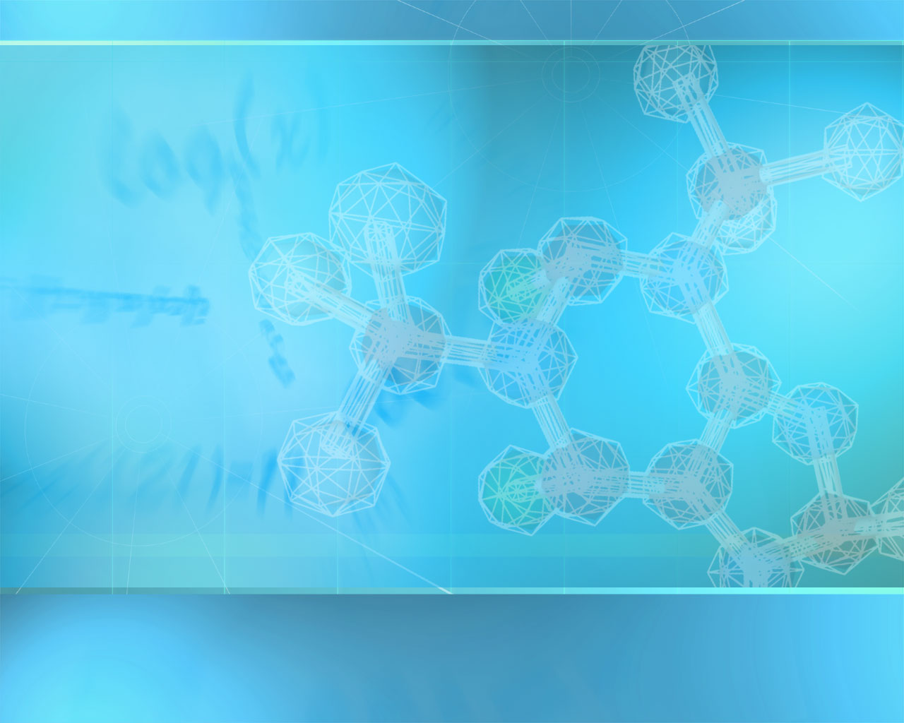
Macromolecules

Slide 2
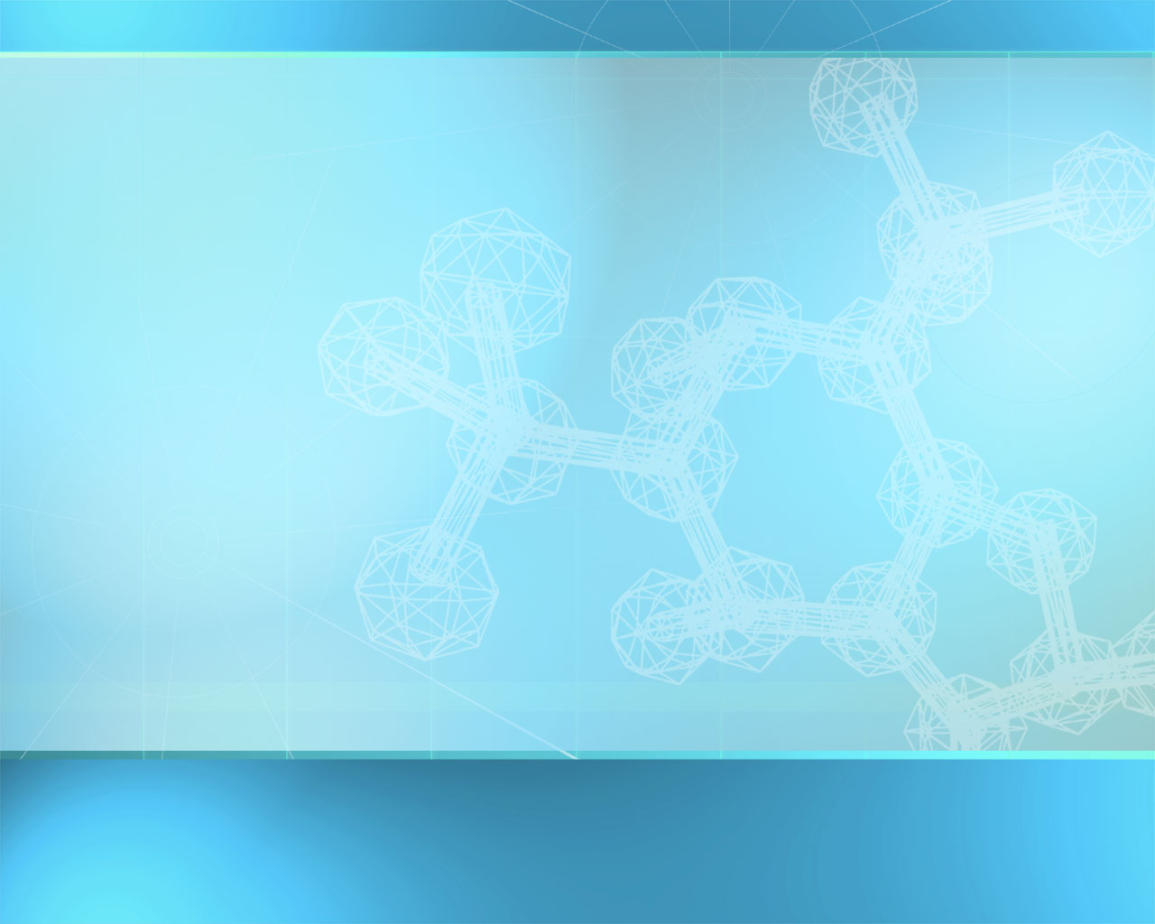
Organic Compounds
Compounds that contain CARBON are called organic.
Macromolecules are large organic molecules.

Slide 3
Carbon (C)
Carbon has 4 electrons in outer shell.
Carbon can form covalent bonds with as many as 4 other atoms (elements).
Usually with C, H, O or N.
Example: CH₄(methane)

Slide 4
Biological Macromolecules
Large organic molecules.
Also called POLYMERS.
Made up of smaller “building blocks” called MONOMERS.
Most biologically important macromolecules molecules fall into the following groups:
1. Carbohydrates
2. Lipids
3. Proteins
4. Nucleic acids (DNA and RNA)

Slide 5
Dehydration Synthesis
How Are Macromolecules Formed?
Also called “condensation reaction”
Forms polymers by combining monomers by “removing water”.
HO
H
HO
H
H₂O
HO
H

Slide 6
Hydrolysis
How are Macromolecules separated or digested?
Separates monomers by “adding water”
HO
H
H₂O
HO
H
HO
H

Slide 7
Carbohydrates
Consist of carbon, hydrogen, & oxygen
Energy containing molecules
Some provide structure
Basic building block is a monosaccharide (CH₂O)_{n} ; n = 3,5,6
Two monosaccharides form a disaccharide
Small sugar molecules to large sugar molecules.
Examples:
A. monosaccharide
B. disaccharide
C. polysaccharide

Slide 8
Carbohydrates
Monosaccharide: one sugar unit
Examples: glucose (C₆H₁₂O₆)
deoxyribose
ribose
Fructose
Galactose
glucose

Slide 9
Carbohydrates
Disaccharide: two sugar unit
Examples:
  Sucrose (glucose+fructose) (Table Sugar)
  Lactose (glucose+galactose) (Milk Sugar)
  Maltose (glucose+glucose)
glucose
glucose

Slide 10
Carbohydrates
Polysaccharide: many sugar units
Examples: starch (bread, potatoes)
glycogen (beef muscle)
cellulose (lettuce, corn)
glucose
glucose
glucose
glucose
cellulose
glucose
glucose
glucose
glucose

Slide 11
Carbohydrates
Important Polysaccharides
Starch and Glycogen:
Starch is energy storage molecule in plants
Glycogen is energy storage molecule in animals.
Starch and glycogen can be digested by animals.
Cellulose:
Different bond formed than starch
Structural component in plants
Cannot be digested by animals
Chitin
Partly derived from non-sugars (nitrogen)
Composes exoskeletons of insects

Slide 12
Lipids
Composed of Carbon, Hydrogen, and Oxygen
Building blocks are fatty acids and glycerol.
Energy storage molecules “stores the most energy”
not soluble in water.
are soluble in hydrophobic solvents.
Examples: 1. Fats
2. Phospholipids
3. Oils
4. Waxes
5. Steroid hormones
6. Triglycerides

Slide 13
Lipids
Six functions of lipids:
1. Long term energy storage
2. Protection against heat loss (insulation)
3. Protection against physical shock
4. Protection against water loss
5. Chemical messengers (hormones)
6. Major component of membranes (phospholipids)

Slide 14
Lipids
Triglycerides:
composed of 1 glycerol and 3 fatty acids.
H
H-C----O
H-C----O
H-C----O
H
O
C-CH₂-CH₂-CH₂-CH₂-CH₂-CH₂-CH₂-CH₂-CH₂-CH₃
=
O
C-CH₂-CH₂-CH₂-CH₂-CH₂-CH₂-CH₂-CH₂-CH₂-CH₃
=
O
C-CH₂-CH₂-CH₂-CH
fatty acids
=
=CH-CH₂-CH₂-CH₂-CH₂-CH₃
glycerol

Slide 15
Fatty Acids
There are two kinds of fatty acids you may see these on food labels:
1. Saturated fatty acids: no double bonds (bad)
2. Unsaturated fatty acids: double bonds (good)
O
C-CH₂-CH₂-CH₂-CH₂-CH₂-CH₂-CH₂-CH₂-CH₂-CH₃
=
saturated
O
C-CH₂-CH₂-CH₂-CH
=
unsaturated
=CH-CH₂-CH₂-CH₂-CH₂-CH₃

